Slide 1
Introduction to Astronomy
AA 201
Fall Semester 2019
Instructor: Manoneeta Chakraborty
Email: manoneeta@iiti.ac.in
Extension: 839
Course webpage: http://www.iiti.ac.in/people/~manoneeta/courses/AA201_2019/

Slide 2
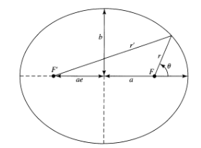

Slide 3
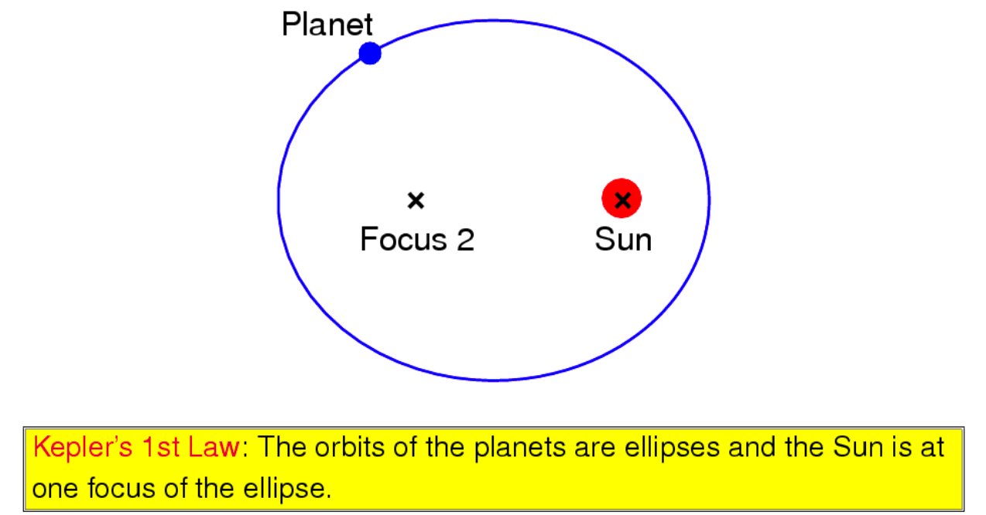

Slide 4
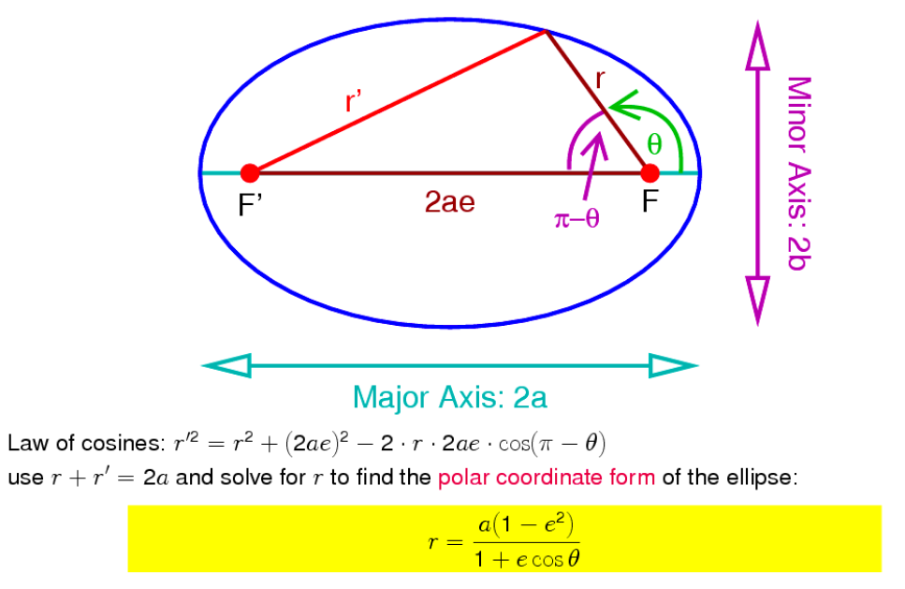

Slide 5
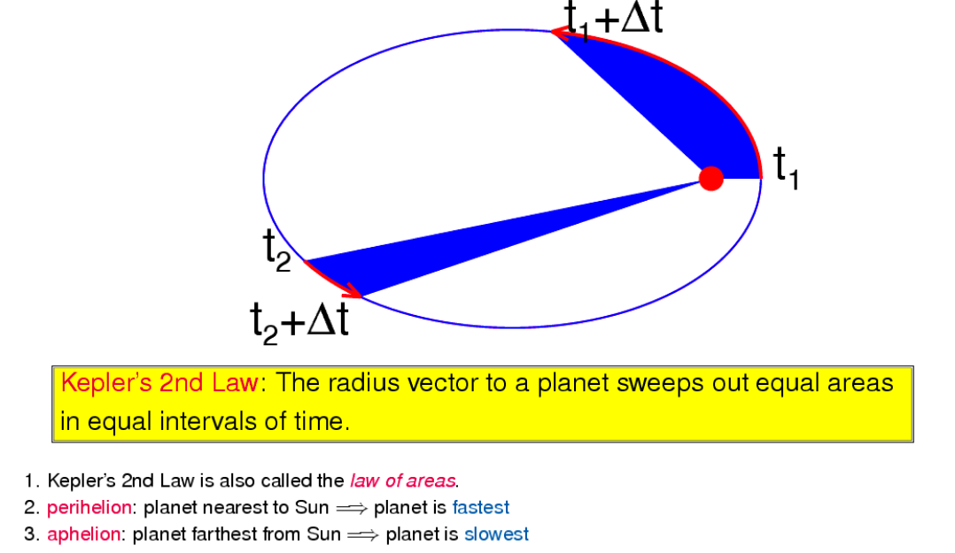

Slide 6
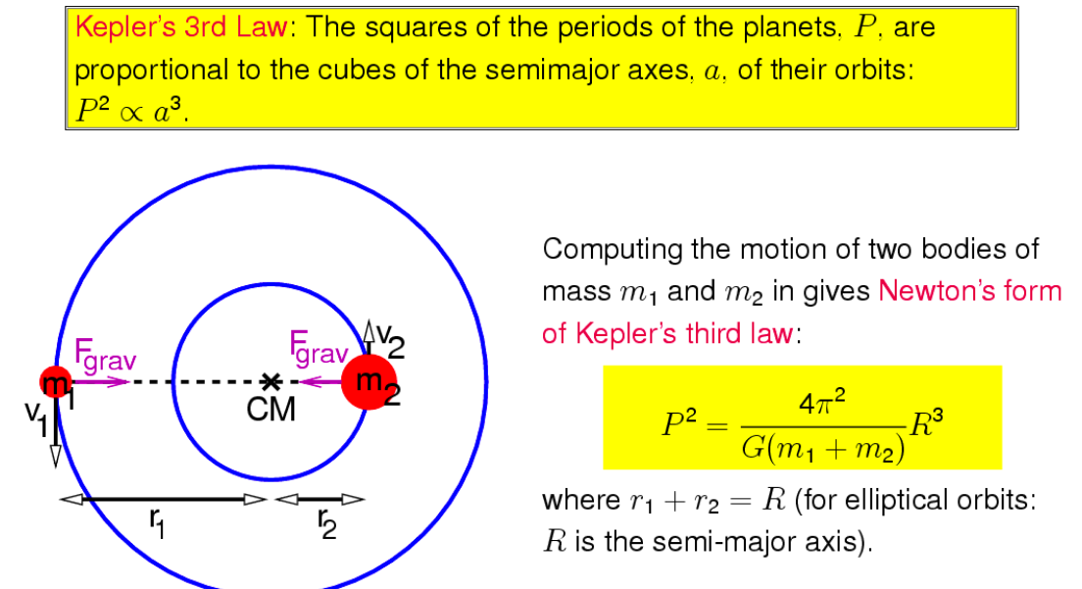

Slide 7
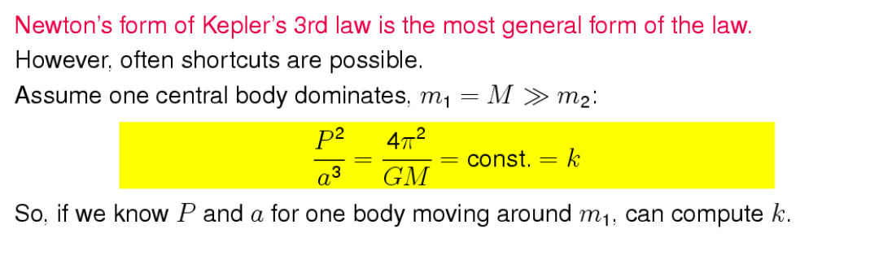

Slide 8
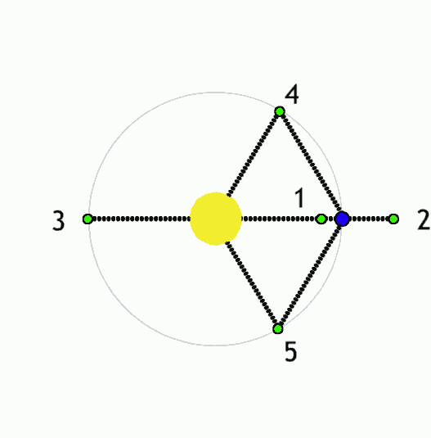

Slide 9
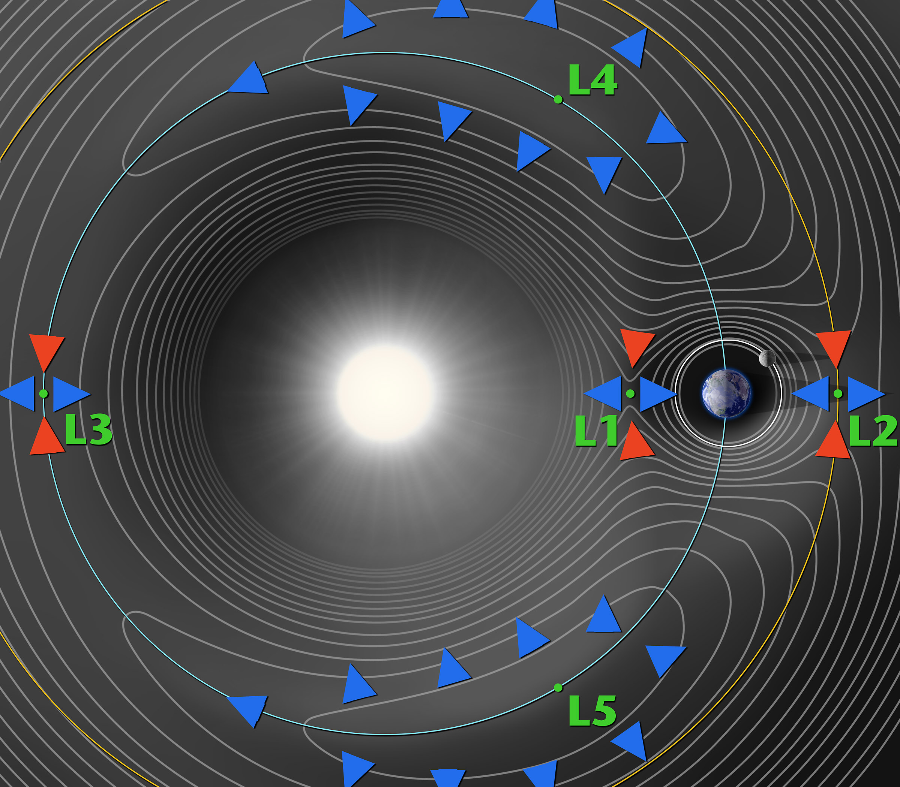

Slide 10
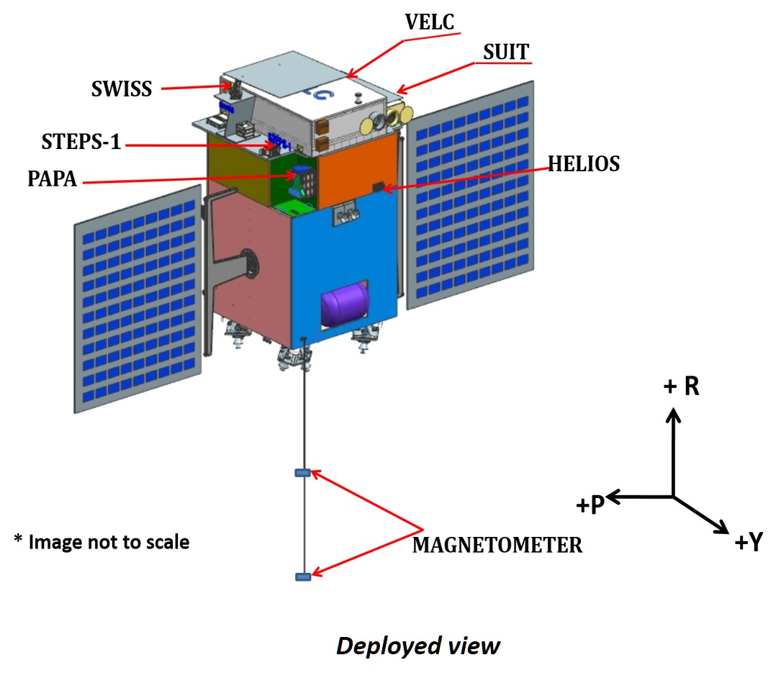
Aditya-L1 : India’s next big mission
Stability with respect to earth and sun
Less fuel consumption to keep in orbit

Slide 11
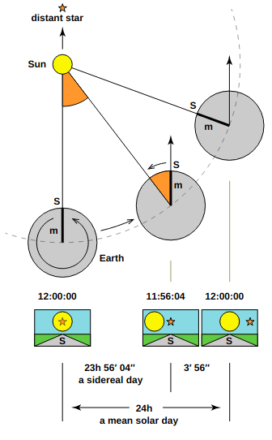
Sidereal time
local sidereal time (LST) = the RA on the observer's meridian
LST = HA_{obj} + RA_{obj}

Slide 12
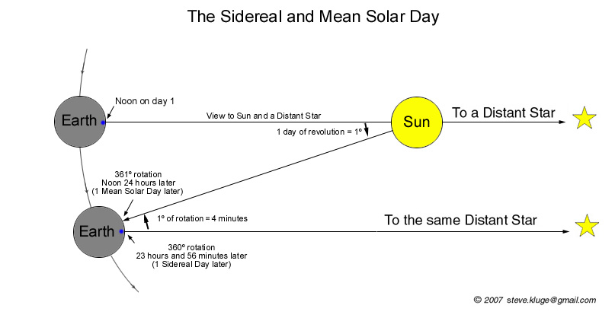

Slide 13
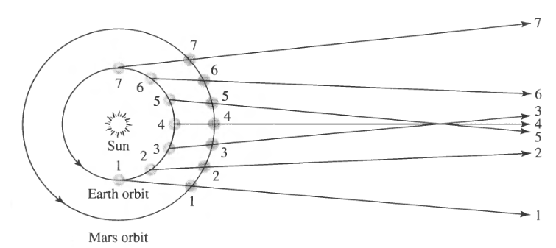
Retrograde

Slide 14
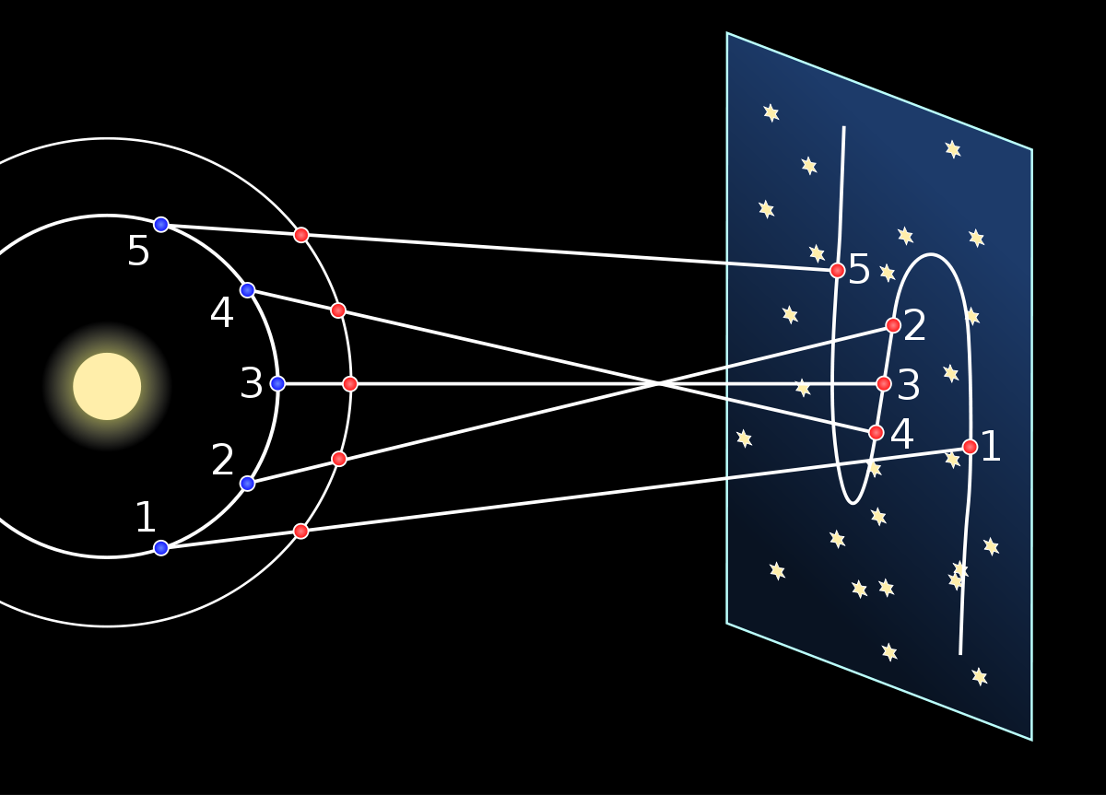

Slide 15
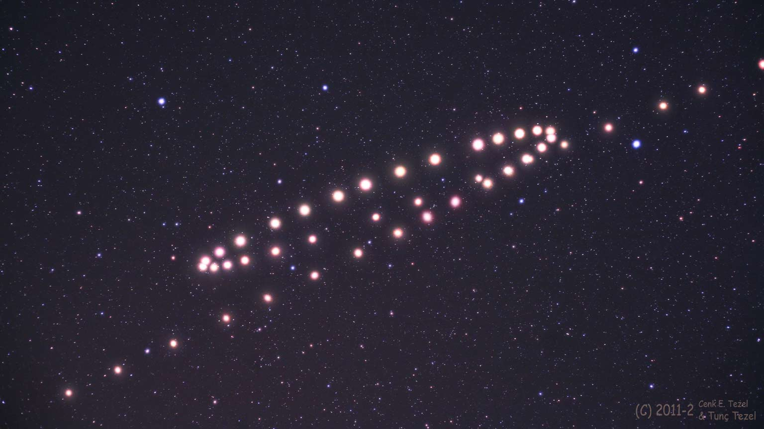

Slide 16
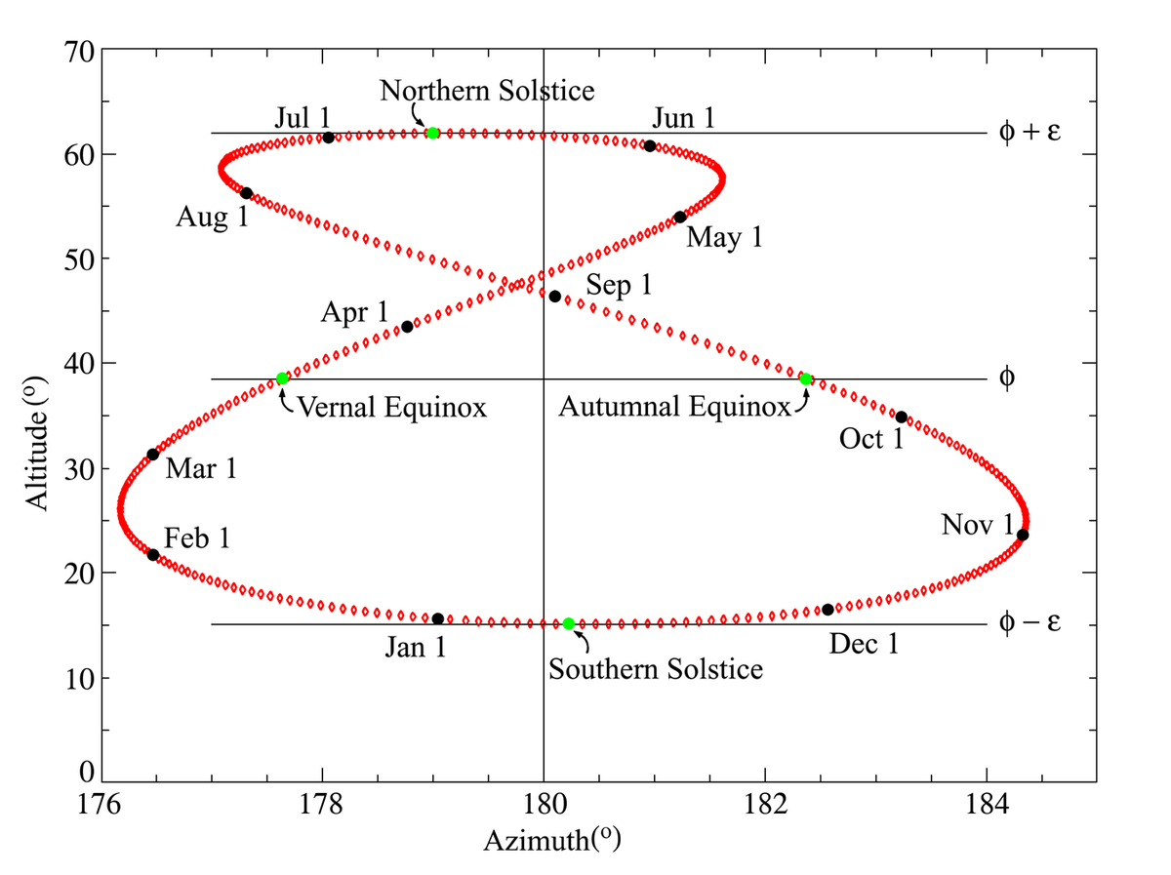
Analemma

