Slide 1
Galactic and Extragalatic Astronomy AA 472/672
Spring Semester
Instructor: Manoneeta Chakraborty Email: manoneeta@iiti.ac.in

Slide 2
Measuring distances and velocities
Trigonometric Parallax
Proper Motion
Moving Cluster parallax
Spectroscopic
Photometric
Visual binary
Pulsating stars
Standard candles

Slide 3
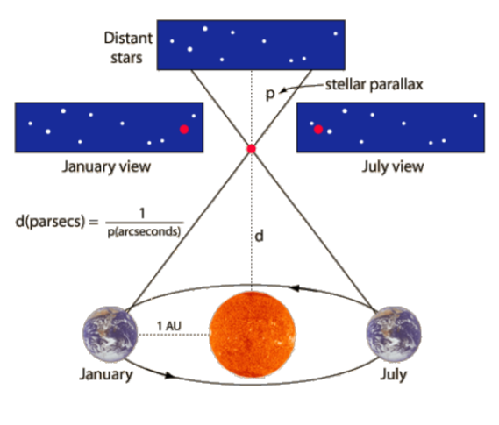
Parallax
Geometric Method
Uses relative change in object’s position due to earth’s orbital motion
r / d = tan p ≈ p
d = ( p / 1’’) pc
Hard to measure angles smaller than ~0.01” even from space, so this limits distances from parallax to ~100 pc
How do we measure distances to stars at larger distances, in order to map the stellar distribution of the galaxy? (Galaxy is > 10 kpc in size)

Slide 4
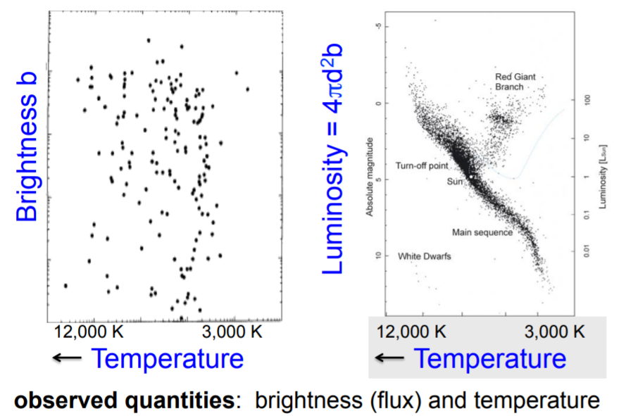
We can measure the flux / intensity of a star in a galaxy through photometry → apparent brightness

Slide 6
Apparent Magnitude
m₁ – m₀ = - 2.5 log₁₀ ( F₁ / F₀ )
Absolute Magnitude M
Distance Modulus
m – M = 5 log₁₀ ( d / 1 pc ) - 5
Luminosity
L = 4 π R² σ T⁴

Slide 7
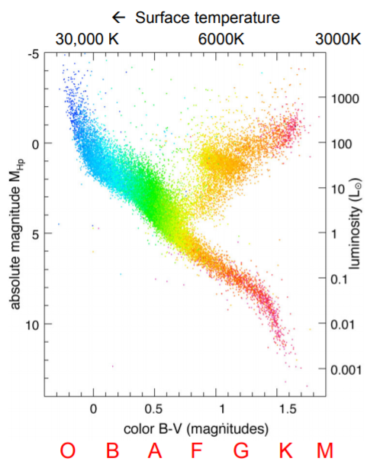
For stars along the main
sequence, there is a ~one-to-one correspondence between
surface temperature (distance
independent) and luminosity (distance dependent)
Use this in combination with photometric measurements of flux to estimate distance
F = L / (4 π d² )
Temperature can be measured from spectrum

Slide 8
How do you distinguish Main Sequence stars from Giant stars?
A. giants are not fusing Hydrogen in core
B. measure apparent size from interferometry
C. deep spectrum shows different line ratios
D. compare widths of spectral lines

Slide 9
How do you distinguish Main Sequence stars from Giant stars?
A. giants are not fusing Hydrogen in core
B. measure apparent size from interferometry
C. deep spectrum shows different line ratios
D. compare widths of spectral lines

Slide 11
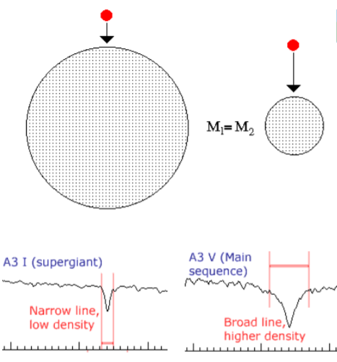
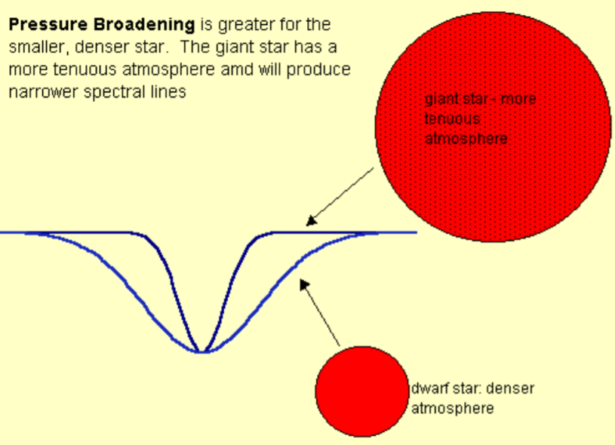
pressure broadening
As the radius of a star decreases the surface gravity increases
In order to balance stronger gravity, a larger pressure gradient (and larger pressure and larger density) is required

Slide 12
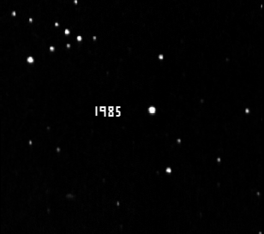
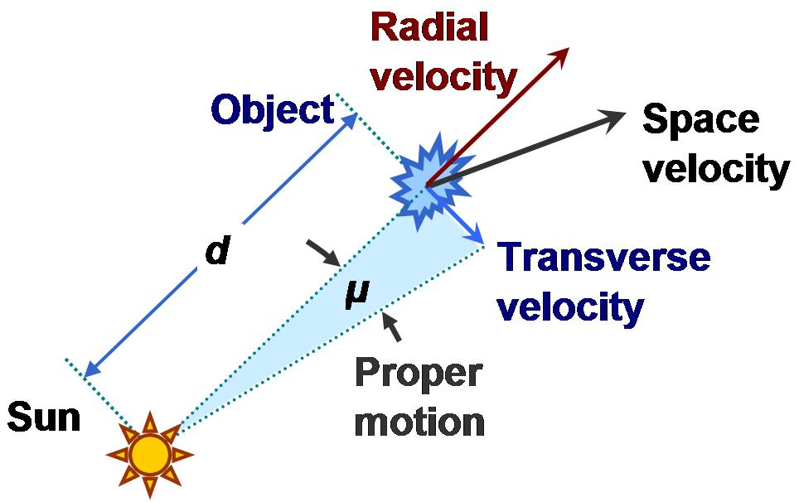
Proper Motion
Vr = ( ∆λ / λ ) . c
V_{t} = d μ
V_{t} = 4.74 ( μ / 1’’ yr⁻¹ ) ( p / 1’’ )⁻¹
V_{t} has both magnitude and velocity
3-D velocity

Slide 13
Extinction
I_{ν}(s) = I_{ν}(0) exp( -τ_{ν}(s) )
Change in distance modulus
A = 2.5 log₁₀ (e) τ_{ν}
Τ_{ν} → optical depth

Slide 14
Cepheids
Periods of light variation are in the range 1 to 60 days and luminosities are up to 40,000 solar luminosities
The surface temperatures are similar to the sun but the star undergoes regular oscillations in size
The maximum expansion velocity occurs at maximum light
Light variation is in the range 0.5 to 2 magnitudes and radial velocities at maximum range from 30 to 60 km/s

Slide 17
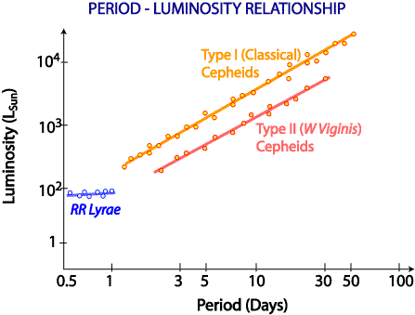
There are two populations of Cepheids.
Type one is the classical type, they are about 4 times brighter than type 2 and have a high metallicity.
Type two are older stars with a low metallicity.

